Slide 1
Deadlock Management
Dept. of Information Technology,
Jadavpur University, Kolkata

Slide 2
Deadlocks
The Deadlock Problem
System Model
Deadlock Characterization
Methods for Handling Deadlocks
Deadlock Prevention
Deadlock Avoidance
Deadlock Detection
Recovery from Deadlock

Slide 3
Deadlocks
A deadlock is a situation in which a set of processes face indefinite waits
  A Deadlock results in reduction of concurrency and parallelism
  Both response times to applications and system performance suffer
A deadlock involving a set of processes D is a situation in which
  Every process P_{i} in D is blocked on some event e_{i}.
  Event e_{i} can be caused only by actions of some process(es) in D.

Slide 4
The Deadlock Problem
In a multiprogramming Environment several processes compete for finite number of resources
A set of blocked processes each holding a resource and waiting to acquire a resource held by another process in the set.
Example 1
  System has 2 disk drives.
  P1 and P2 each holds one disk drive and each needs another
Example 2
  semaphores A and B, initialized to 1
        P0 P1
        wait (A); wait(B)
        wait (B); wait(A)
Example 3
  Each philosopher picks left chopstick in dining philosopher problem

Slide 5
Bridge Crossing Example
Traffic only in one direction.
Each section of a bridge can be viewed as a resource.
If two cars approach each other at the crossing, neither can start until the other has gone(Dead lock)
If a deadlock occurs, it can be resolved if one car backs up (preempt resources and rollback).
Several cars may have to be backed up if a deadlock occurs.
Starvation is possible.

Slide 6
System Model
Resource types R1, R2, . . ., Rm
    CPU cycles, memory space, I/O devices
Each resource type Ri has Wi instances.
  Example—two CPU, Three printers, 2 disk drives
Process may requests as many resources as it requires to perform its designated task
  Must be less the total number of resources available
Each process utilizes a resource as follows:
  Request—If the request can not be granted immediately, the requesting process must wait
  Use
  Release

Slide 7
Deadlock Characterization
Deadlock can arise if four conditions hold simultaneously.
Mutual exclusion:
  at least one resource must in non-sharable mode i.e. only one process at a time can use that resource.
Hold and wait:
  a process holding at least one resource is waiting to acquire additional resources held by other processes.
No preemption:
  a resource can be released only voluntarily by the process holding it, after that process has completed its task.
Circular wait:
  there exists a set {P0, P1, …, Pn} of waiting processes such that P0 is waiting for a resource that is held by P1, P1 is waiting for a resource that is held by P2, …, Pn–1 is waiting for a resource that is held by Pn, and Pn is waiting for a resource that is held by P0.

Slide 8
Resource-Allocation Graph
Used to visualize resource allocation pattern
Helps to describe deadlock more precisely
A set of vertices V and a set of edges (directed) E
V is partitioned into two types:
  P = {P1, P2, …, Pn}, the set consisting of all the processes in the system.
  R = {R1, R2, …, Rm}, the set consisting of all resource types in the system.
E is partitioned into two types:
  request edge – directed edge Pi → Rj
  assignment edge – directed edge Rj → Pi

Slide 9
Resource-Allocation Graph(Cont.)
Process
Resource Type with 4 instances
P_{i} requests an instance of R_{j}
P_{i} is holding an instance of R_{j}
P_{i}
R_{j}
P_{i}
R_{j}

Slide 10

Example of Resource Allocation Graph
The sets P, R and E
  P = {P1, P2, P3}
  R = {R1, R2, R3, R4}
  E = {P1→ R1, P2→ R3, R1→ P2 ,
  R2→ P2, R2→ P1, R3→ P3}
Resource Instances
  One instance of resource type R1
  Two instances of resource type R2
  One instance of resource type R3
  Three instances of resource type R3

Slide 11
Basic facts
If graph contains no cycles ⇒ no deadlock.
If graph contains a cycle ⇒
  if only one instance per resource type, then deadlock.
  if several instances per resource type, possibility of deadlock.

Slide 12

Resource Allocation Graph With A Deadlock

Slide 13

Graph With A Cycle But No Deadlock

Slide 14
Methods of Handling Deadlock
Three methods for dealing with the deadlock problem
  Ensure that the system will never enter a deadlock state.
    Deadlock prevention—ensure that one of the necessary conditions can not hold
    Deadlock avoidance—systems additional information about resource usage pattern during the execution
  Allow the system to enter a deadlock state and then recover.
  Ignore the problem and pretend that deadlocks never occur in the system; used by most operating systems, including UNIX.

Slide 15
Deadlock Prevention
Ensure that one of the necessary conditions can not hold
Restrict the ways request can be made.
Mutual Exclusion – not required for sharable resources; must hold for nonsharable resources.
Hold and Wait – must guarantee that whenever a process requests a resource, it does not hold any other resources.
Two possibilities
  Require process to request and be allocated all its resources before it begins execution
  allow process to request resources only when the process has none.
    Low resource utilization; possibility of starvation
    Data inconsistency

Slide 16

Deadlock Prevention(Cont.)
No Preemption –
Two possibilities
  If a process that is holding some resources requests another resource that cannot be immediately allocated to it, then all resources currently being held are released.
  If a process requests some resources that are not available as they are allocated to other waiting processes, then preempt desired resources from waiting processes
    Preempted resources are added to the list of resources for which the process is waiting.
    Process will be restarted only when it can regain its old resources, as well as the new ones that it is requesting.

Slide 17
Deadlock Prevention(Cont.)
Circular Wait – impose a total ordering of all resource types, and require that each process requests resources in an increasing order of enumeration.
  F(tape drive)=1
  F(disk drive)=5
  F(printer)=12
Facts:I
  If a process currently holds resource type R_{i} , the process can request another resource type R_{j} if F(R_{j}) > F(R_{i})
  OR
  If a process requests a resource type R_{j} , if it has released any resource type R_{i} such the F(R_{i}) ≥ F(R_{j})
Proof(by contradiction):
  Set of deadlocked process {P₀, P₁, P₂, …, P_{n}}
  F(R₀) < F(R₁) < F(R₂) <…< F(R_{n}) < F(R₀) which is impossible
  So there can be no circular wait—no deadlock

Slide 18
Resource ranking
Associate numerical ranks with resources
When process P_{i} requests a resource R_{k} with rank r_{k}
  Abort process P_{i} if r_{k} is ≤ the rank of some resource already allocated to P_{i}
  Allocate resource R_{k} if it is available; otherwise, let process P_{i} wait for resource R_{k}
  Q: Can one prove absence of deadlocks when this policy is used?

Slide 19
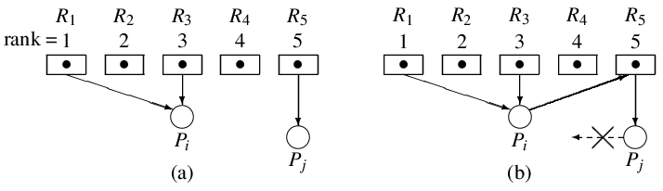
Deadlock prevention using resource ranking

Slide 20
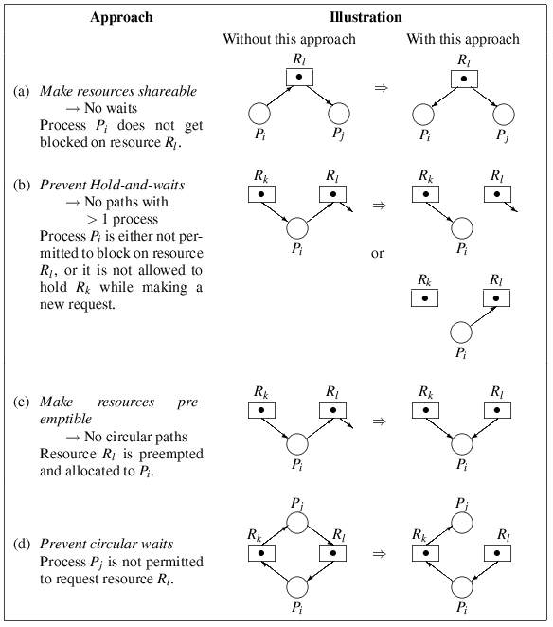

Slide 21
Deadlock Avoidance
  Requires that the system has some additional information available.
  With this additional information, system can decide whether a newly arrived request can be satisfied (served) or not
Simplest and most useful model requires that each process declare the maximum number of resources of each type that it may need.
The deadlock-avoidance algorithm dynamically examines the resource-allocation state to ensure that there can never be a circular-wait condition.

Slide 22
Safe State
state is defined by the number of available and allocated resources, and the maximum demands of the processes.
System is in safe state if there exists a sequence <P₁, P₂, …, P_{n}> of ALL the processes in the systems such that for each P_{i}, the resources that P_{i} can still request can be satisfied by currently available resources + resources held by all the P_{j}, with j < i.
That is:
  If P_{i} needs some resources that are not immediately available, then P_{i} can wait until all P_{j} have finished.
  When P_{j} is finished, P_{i} can obtain needed resources, execute, return allocated resources, and terminate.
  When P_{i} terminates, P_{i +1} can obtain its needed resources, and so on.
When a process requests an available resource, system must decide if immediate allocation leaves the system in a safe state.

Slide 23
Basic Facts
If a system is in safe state ⇒ no deadlocks.
If a system is in unsafe state ⇒ possibility of deadlock.
Avoidance ⇒ ensure that a system will never enter an unsafe state.
Example:
12 disk drives
Snapshot at time T₀:
Maximum needs Current Needs
P₀ 10 5
P₁ 4 2
P₂ 9 2
The sequence <P₁, P₀, P₂> is safe
At time T_{1,} P₂ requests one more disk drive
Satisfying the request leaves the system in an unsafe state
Request can not be granted

Slide 24

Safe, Unsafe and Deadlock state

Slide 25
Deadlock Avoidance Algorithms
Single instance of a resource type. Use a resource-allocation graph
Multiple instances of a resource type. Use the banker’s algorithm

Slide 26
Resource-Allocation Graph Scheme
Claim edge P_{i} → R_{j} indicated that process P_{j} may request resource R_{j}; represented by a dashed line.
Claim edge converts to request edge when a process requests a resource.
Request edge converted to an assignment edge when the resource is allocated to the process.
When a resource is released by a process, assignment edge reconverts to a claim edge.
Resources must be claimed a priori in the system.

Slide 27

Resource Allocation Graph

Slide 28
Resource-Allocation Graph Algorithm
Suppose that process P_{i} requests a resource R_{j}
The request can be granted only if converting the request edge to an assignment edge does not result in the formation of a cycle (including the claim edge )in the resource allocation graph

Slide 29

Unsafe state and Resource Allocation Graph

